Slide 1
RUNGTA COLLEGE OF DENTAL SCIENCES & RESEARCH
TITLE OF THE TOPIC: AMALGAM
DEPARTMENT OF CONSERVATIVE DENTISTRY AND ENDODONTICS

Slide 2
Specific learning Objectives
At the end of this presentation the learner is expected to know ;
Core areas* | Domain ** | Category #
COMPOSITION CLASSIFICATION OF AMALGAM | COGNITIVE | MUST KNOW
INDICATIONS ADVANTAGES METALLURGICAL PHASES | PSYCHOMOTOR | NICE TO KNOW
TERMONOLOGIES | AFFECTIVE | DESIRE TO KNOW

Slide 3
Table of Content
HISTORICAL BACKGROUND
CONSTITUENTS
CLASSIFICATION OF AMALGAM ALLOY
INDICATION AND CONTRAINDICATION
ADVANTAGES AND DISADVANTAGES
METALLURGICAL PHASES
DIMENSIONAL CHANGES
REFERENCES

Slide 4
HISTORICAL BACKGROUND
Used as a dental restorative material from the beginning of the 19th century.
Amalgam was made by mixing mercury with the fillings from Spanish or Mexican silver coins (high silver content).

Slide 5
TERMINOLOGY | DEFINITION
Amalgam | Amalgam is an alloy which has mercury as one of its components – Marzouk (1997)
Dental Amalgam | An alloy of mercury, silver, copper, tin, which may also contain palladium, zinc, and other elements to improve handling characteristics and clinical performance – Anusavice (2003)
Dental Amalgam Alloy / Alloy for Dental Amalgam | An alloy of silver, copper, tin, and other elements that is formulated and processed in the form of powder particles or as a compressed pellet – Anusavice (2003)

Slide 6
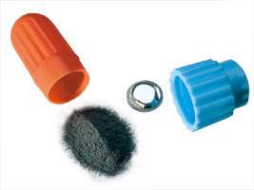
Constituents of Amalgam
As per ADA Specification No. 1
Basic
Silver
Tin
Copper
Mercury
Others
Zinc
Indium
Palladium

Slide 7
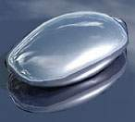
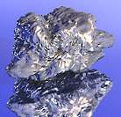
Basic Constituents
Silver (Ag)
Increases strength
Increases expansion
Decreases creep
Tin (Sn)
Decreases expansion
Decreases strength
Reduces the resistance to tarnish
and corrosion
Phillip’s Science of Dental Materials 2003

Slide 8
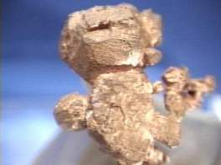
Basic Constituents
Copper (Cu)
Increases strength
Reduces tarnish and corrosion
Reduces creep
reduces marginal deterioration
Phillip’s Science of Dental Materials 2003

Slide 9
Basic Constituents
Mercury (Hg)
Activates reaction
Only pure metal that is liquid at room temperature
Spherical alloys
require less mercury
smaller surface area easier to wet
40 to 45% Hg
Admixed alloys
require more mercury
lathe-cut particles more difficult to wet
45 to 50% Hg
Phillip’s Science of Dental Materials 2003

Slide 10
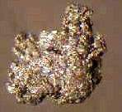
Other Constituents
Indium (In)
Decreases surface tension
reduces amount of mercury necessary
reduces emitted mercury vapor
Reduces creep and marginal breakdown
Increases strength
Must be used in admixed alloys
Powell J Dent Res 1989

Slide 11
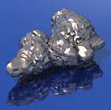
Other Constituents
Zinc (Zn)
Used in manufacturing
decreases oxidation of other elements
acts as scavenger or deoxidizer
Provides better clinical performance
less marginal breakdown
Causes delayed expansion with low Cu alloys
if contaminated with moisture during condensation or trituration.
⇒
H₂O + Zn ZnO + H₂
Phillip’s Science of Dental Materials 2003

Slide 12
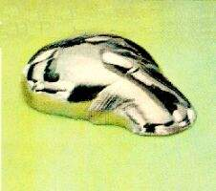
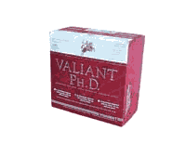
Other Constituents
Platinum and Palladium (Pd)
Reduces corrosion
Hardens the alloy
Mahler J Dent Res 1990

Slide 13
CLASSIFICATION OF AMALGAM ALLOYS
1. BASED ON COPPER CONTENT:
a) Low copper alloys : contains less than 6% of copper .
b) High copper alloys : contains more than 6% of copper.
-Admixed or dispersion alloys .
-Single composition alloys.
2. BASED ON ZINC CONTENT
a) Zinc containing alloys: contains less than 0.01% zinc
b) Non zinc/Zinc free alloys: contains equal to less than 0.01%

Slide 14
COPPER CONTENT
Composition | LOW COPPER | HIGH COPPER
 |  | Admixed |  | Unicomposition
Particle shape | Lathe- Cut / Spherical | Lathe-cut (2/3) | Spherical (1/3) | Spherical
Silver | 63-70% | 40-70 % | 40-65 % | 40-60 %
Tin | 26-23 % | 26-30 % | 0-30 % | 22-30 %
Copper | 2-5 % | 2-30 % | 20-40 % | 13-30 %
Zinc | 0-2 % | 0-2 % | 0 % | 0-4 %

Slide 15
3. BASED ON SHAPE OF ALLOY PARTICLES
a) Lathe cut alloys –irregular shape.
b) Spherical alloys
c) Admix alloys
4. BASED ON NUMBER OF ALLOYED METALS
a) Binary alloys – Ag Sn
b) Ternary alloys – Ag Sn Cu
c) Quaternary alloys- Ag Sn Cu In
5. BASED ON SIZE OF ALLOY
a) Micro-cut
b) Fine-cut
c) Coarse cut

Slide 16
INDICATIONS
- As permanent filling material in
Class 1 and Class 2 cavities and
Class 5 cavities where esthetics is not a prime
consideration
In combination with metallic retentive pins to restore a crown
For making dies
In retrograde root canal filling

Slide 17
CONTRAINDICATIONS
Anterior teeth and clearly visible surfaces of posterior teeth.
Allergy to any component of amalgam, proven by skin test, conducted by trained dermatologist.
Patient’s with proven amalgam – induced lichenoid lesions.
Remaining tooth structure requires support / would require extensive preparation to accommodate amalgam.
Treatment of incipient / early primary fissure caries.

Slide 18
ADVANTAGES
Easy to insert
Not overly technique sensitive
Maintain anatomical form
Adequate resistance to fracture
Prevent marginal leakage
Can be used in stress bearing areas
Relatively long service life

Slide 19
DISADVANTAGES
Non esthetic
Brittle
Subject to corrosion and galvanic action
May show a degree of marginal breakdown
Do not help retain weakend tooth structure
Regulatory concerns about disposal of amalgam

Slide 20
TAKE HOME MESSEGE/ FOR THE TOPIC COVERED (SUMMARY)
Dental amalgam are widely used by the dental profession in most parts of the world
Some countries like swedan, Canada and Germany, uk have either banned or imposed serious limitation on amalgam usage
The American dental association council on scientific affairs has conclude that both amalgam and composite materials are considered safe and effective for tooth restoration .

Slide 21
Question & Answer Session
Students should be given opportunity to ask question for clarifying for their understand/ confusions. Teachers must spend 5-10 minutes for this to improve the output.

Slide 22
REFERENCES
STURVEDANTS art and science of operative dentistry text book of operative dentistry NISHA GARG AND AMIT GARG

Slide 23
THANK YOU

